Slide 1
PILGRIMAGE -By Shiv K. Kumar
--

Slide 2
Not all of us spoke the same language— some cowered under the sun's threats and the dwindling supplies, others felt amused at the enforced equalities. The bystanders took us for a Persian mosaic of some insidious design.

Slide 3
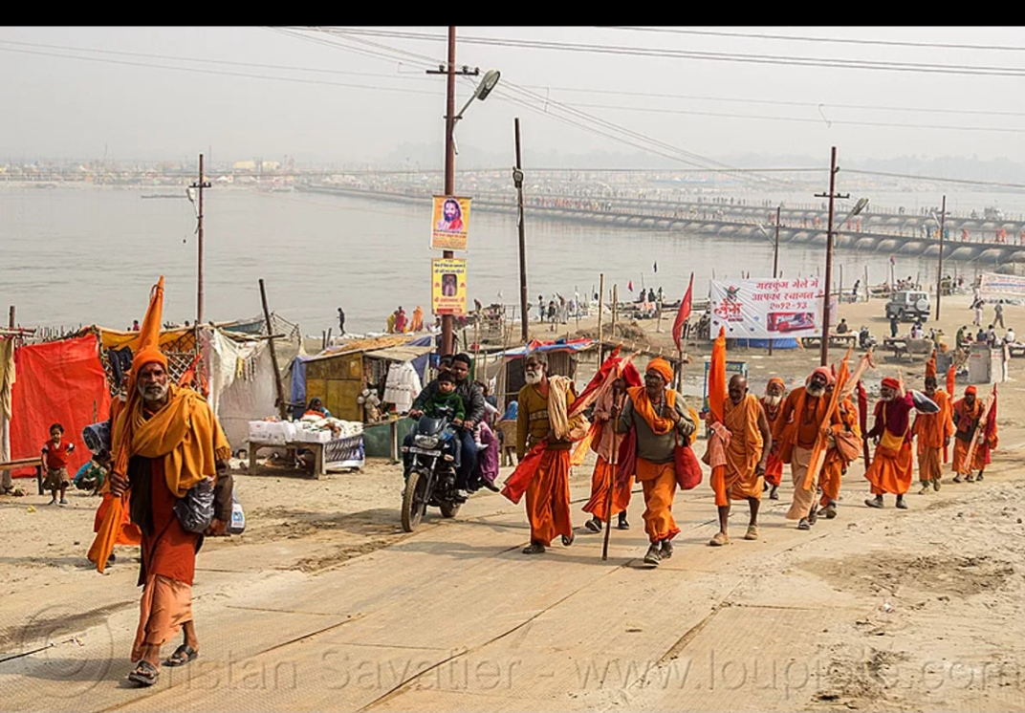

Slide 4
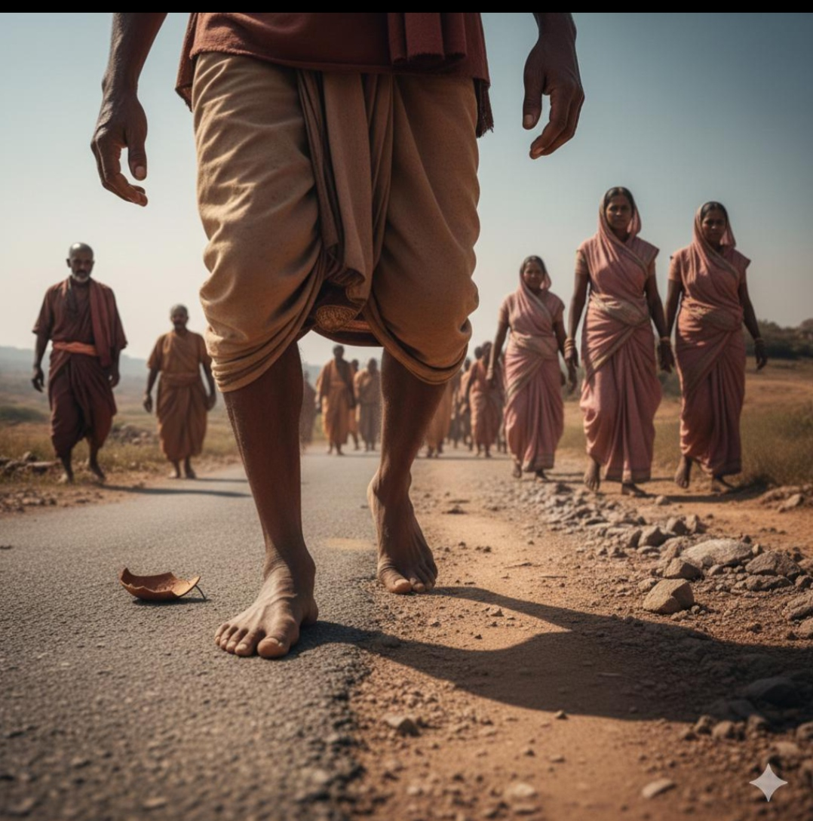

Slide 5
Sometimes the urge to feign was paramount. I pretended ataxia to lag behind and visualize more sharply the road's last, devious curve.

Slide 6
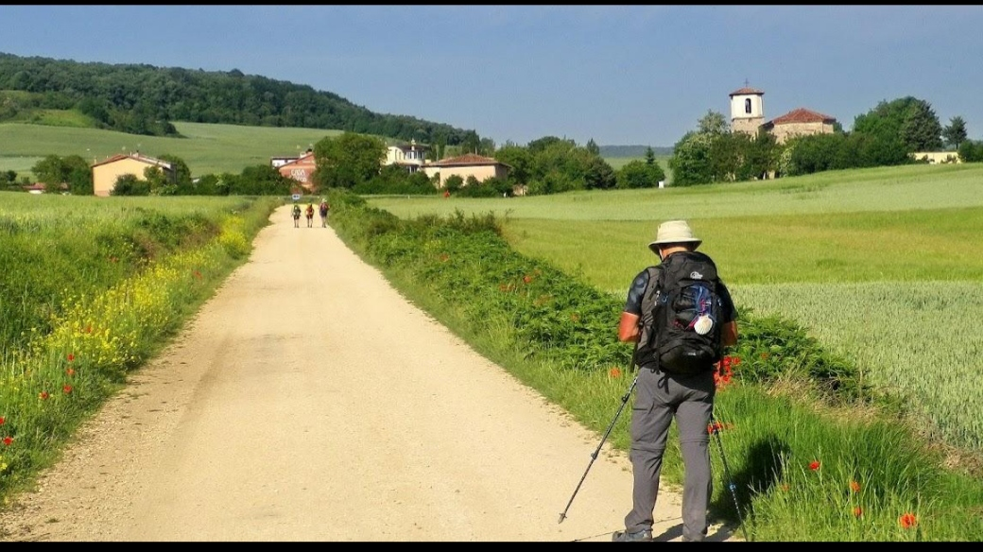

Slide 7
The trees on either side would have given us a guard of honour had our leader not defiled them with blasphemies.

Slide 8
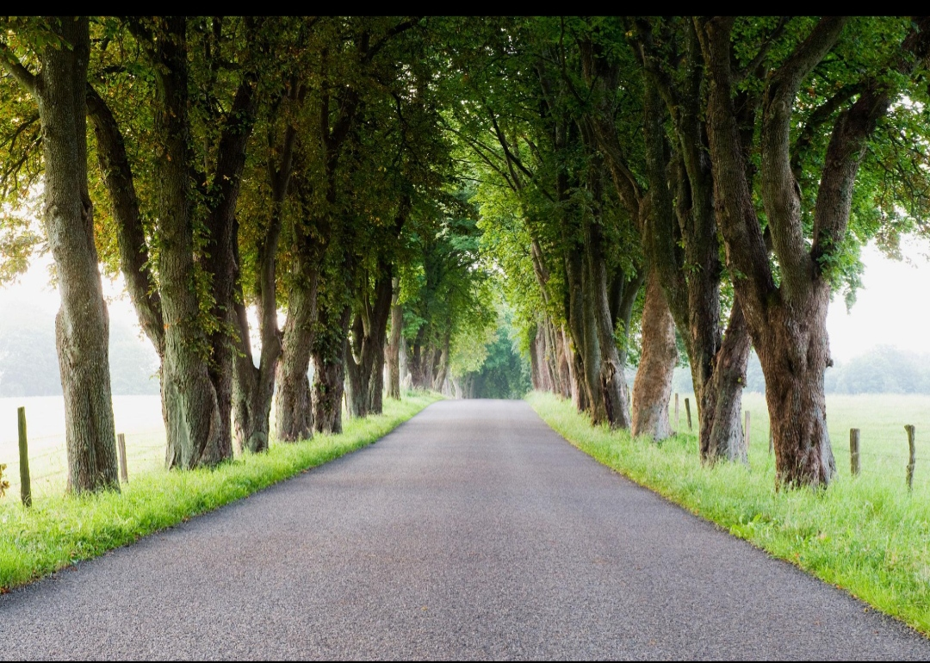

Slide 9
Then suddenly someone announced that the easiest way to hit the destination was to march crabwise.

Slide 10
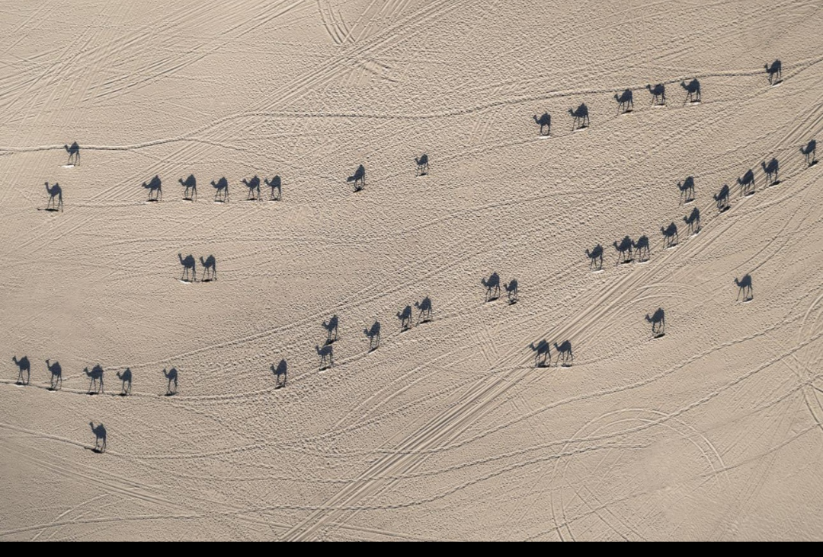

Slide 11
We were out to span the sky's amplitude— this journey was merely to stimulate the blood. The women mumbled, 'Rest would be haven— indeed.'

Slide 12
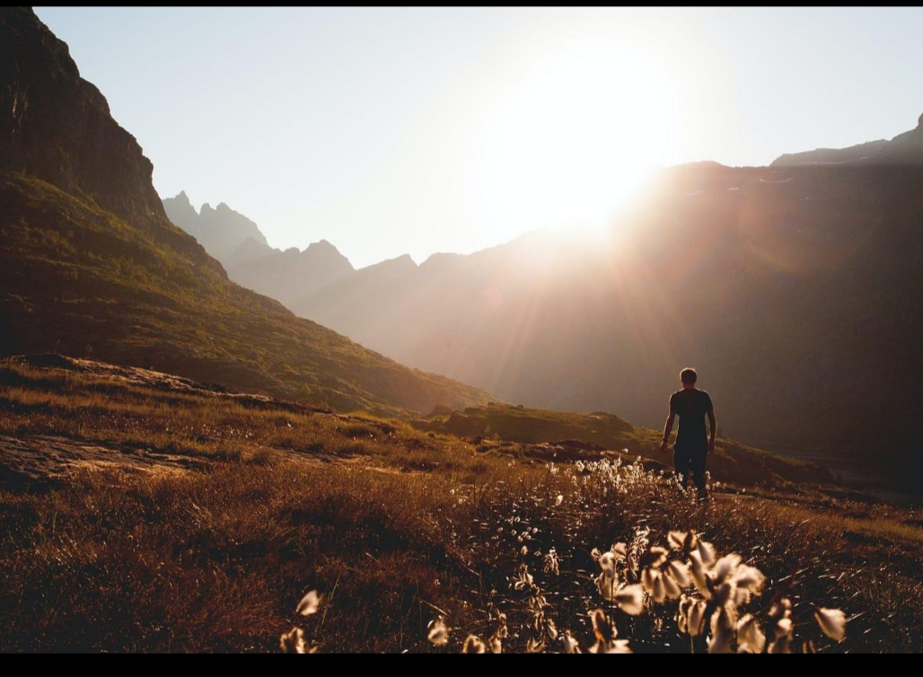

Slide 13
I was the only one to caution that the gods had trapped us into belief.

Slide 14
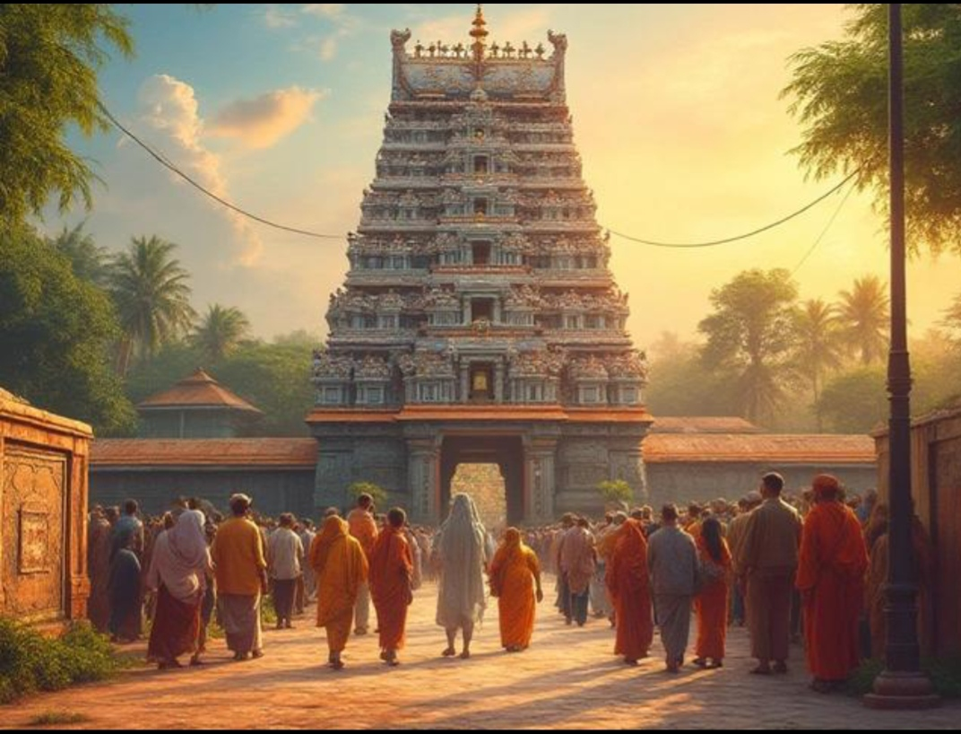

Slide 15
Thank You
Will meet soon…

